Slide 1
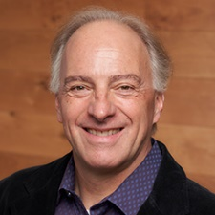
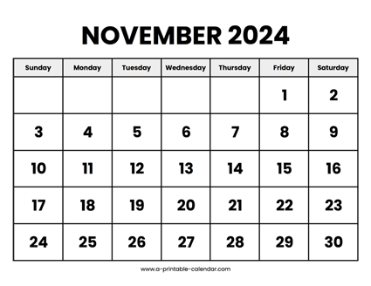

CS 310 : Scalable Software Architectures
Week 07 (Nov 04 – Nov 08)
This week in CS 310:
Focus this week:
Serverless computing, API Gateway, Docker
Project 03 has been released
Serverless, event-driven PDF analysis
Due Friday November 15th (late Sunday Nov 17th)

Slide 2
Topics
Serverless computing
API Gateway + lambda functions
Packaging
Docker

Slide 3
Class sessions
Tuesday:
We'll build another example using API Gateway and lambda
Thursday:
Work with Docker

Slide 4
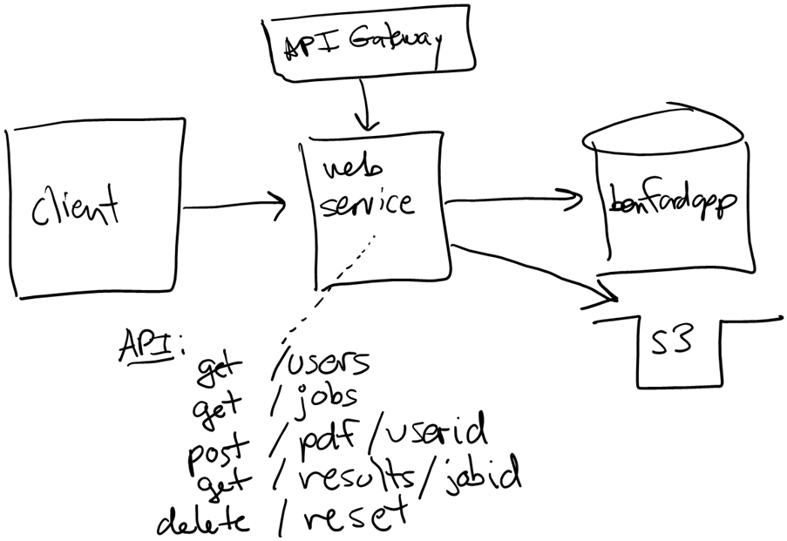
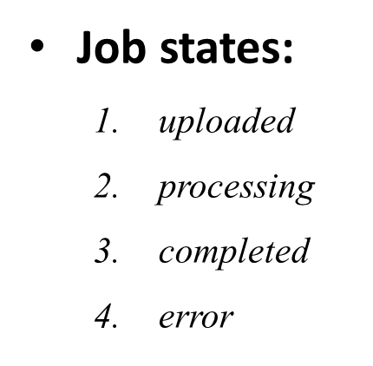
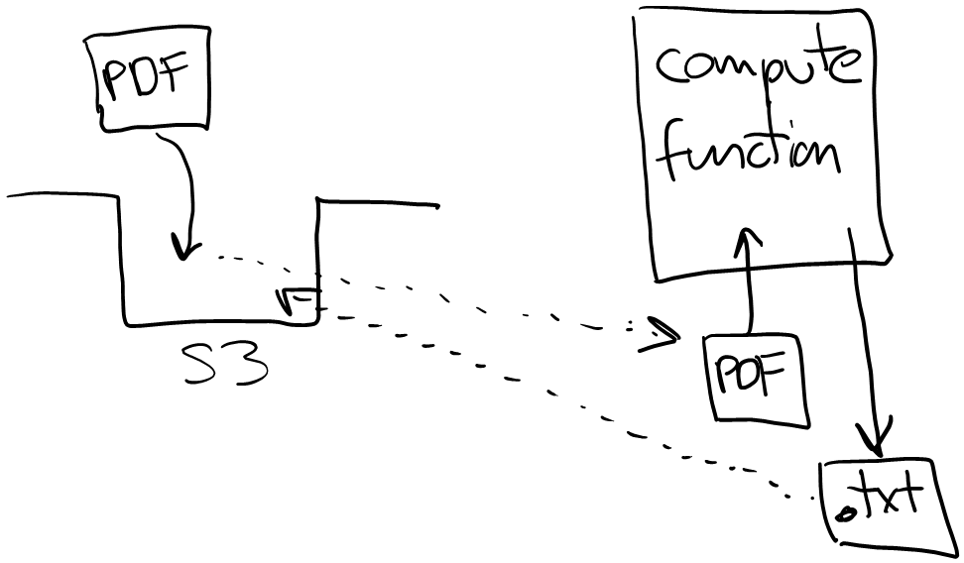
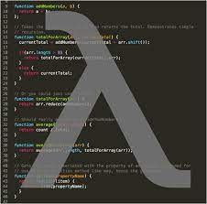
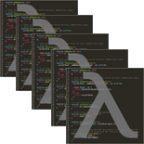
Project 03
Project 03 uses a different architectural approach:
Serverless with API Gateway + Lambda functions
Event-driven
Asynchronous API

